Slide 1
Digitalisation and Government Bond
Dr. Pál Péter Kolozsi, Government Debt Management Agency Pte. Ltd. (ÁKK)
8th Budapest Public Finance Seminar: Sovereign Money, 13 May 2026

Slide 2
Overview and relevance
Examples of digital money
Relevance for sovereign bond issuer
Cryptocurrency (Bitcoin Ethereum, Stablecoin)
Central Bank Digital Currency – CBDC (Nigeria: e-Naira)
Virtual money (Mobile game money)
Digital money and assets are becoming interoperable and tradable with each other, which can open up new opportunities for sovereign debt management:
e.g. purchase of government bonds using cryptocurrencies through conversion mechanisms
e.g. tokenised issuance of sovereign government bond using blockchain technology to improve efficiency
Slovenia (2024): T+1 settlement of a tokenised bond issuance using wholesale CBDC via Banque de France’s tokenized cash solution on the Neobonds platform.
Hong Kong (2025): T+1 settlement of a tokenised green bond issuance using tokenised central bank money (in the form of e-CNY, e-HKD) on HSBC Orion platform.
Examples of digital assets
Tokenised equities
Real-world assets (PAX Gold)
Tokenised bonds
Source: https://www.icmagroup.org/fintech-and-digitalisation/fintech-resources/tracker-of-new-fintech-applications-in-bond-markets/
Notes:
Financial transactions are increasingly shifting into the digital space. Future generations are making greater use of digital environments. Digitalization is appearing across many areas of the financial world in a variety of forms.
The financial system is increasingly shifting into a fully digital environment, where both money and assets exist in digital form. On the one hand, there is an emergence of digital money, such as cryptocurrencies and central bank digital currencies. On the other hand, financial and real-world assets are also becoming digital through tokenization, including equities, real-world assets, and bonds. Tokenisation is predominantly done on blockchain. Blockchain technology uses distributed ledger technology, that enables the secure transfer of information and digital assets through a shared network, where participants agree on and verify transactions using consensus mechanisms.
Tokenization converts ownership of tangible (real estate, art, gold) or intangible assets into digital tokens. These tokens represent fractional ownership, enabling secure, transparent, and 24/7 trading on decentralized ledgers, which significantly increases liquidity and accessibility for traditionally illiquid, high-value assets. Fractionalised ownership refers to the possibility of dividing traditionally indivisible or high-value assets into smaller, more accessible units represented as digital tokens.
Digital bonds are the most prominent application of tokenization. In tokenised bond issuances, issuers and investors can convert their bonds and fiat currencies to tokens on digital platforms respectively. Once tokenised, their bonds and fiat currencies can be exchanged wallet-to-wallet, without the need for financial intermediaries. In contrast, when issuing a conventional bond, issuers and investors have to go through brokers as intermediaries.
What is increasingly important is that these digital forms of money and assets are becoming interoperable and tradable with each other across global markets. This opens up new potential use cases for sovereign debt management as well, where governments could benefit from more efficient issuance processes and broader investor access through digital infrastructure.
For example, this could include scenarios such as the purchase of government bonds using crypto-based capital through conversion mechanisms, or the issuance of tokenized sovereign bonds that can be traded within digital asset ecosystems. Counties like, Slovenia and Hong Kong already issued digital bonds where the settlement time was only one business day and the settlement of the tokenised bonds was with the use of tokenised central bank money. According to several reports, in 2024, digital bond issuance amounted to around 3,000 million EUR, which is still a very small fraction of the total bond market:
https://www.ecb.europa.eu/press/financial-stability-publications/macroprudential-bulletin/html/ecb.mpbu202604_03.en.html
https://www.afme.eu/media/bskh0gmm/afme-dlt-report-2025-september.pdf

Slide 3
What are the benefits and challenges of blockchain-based tokenised issuance?
Benefits
Challenges
Issuance efficiency and lower issuance costs (smart contracts, no intermediaries, faster settlement)
Lower yields
Broader investor base
Improved market liquidity
Price discovery of conventional bonds issued by the same issuers
Energy consumption and environmental impact
Significant adjustment needs for infrastructure of financial markets and technology
Legal and regulatory risks
Data protection
Business risk
Notes:
Benefits:
Theoretically, tokenisation may enhance issuance efficiency by automating the multi-step process for issuance, interest payment and principal repayment through the use of smart contracts. Conventional bond issuance involves multiple intermediaries such as underwriters, who charge fees for their services. In contrast, tokenisation streamlines the bond issuance process by automating the manual process and eliminating paper trails. These may reduce the operational cost of bond issuance, including the underwriting fees.
The issuers may also be able to issue tokenised bonds at lower yields, as investors may favour their unique features, such as the high transparency, speedier settlement cycles, round-the-clock trading without intermediaries, and fractionalised bond ownership which allows for an unrestrictedly small amount in transactions → the fractionalised bond ownership may lower the entry barrier of those bonds that were once illiquid to ordinary investors.
Tokenisation may improve market liquidity, given that the aforementioned features of tokenised bonds may reduce the transaction costs and broaden the investor base. In addition, the magnitude of liquidity improvement is likely to be greater for those bonds that are open to retail investors, as they are more likely to benefit from the lower entry barrier and increased access to the market.
Tokenisation may improve the liquidity of conventional bonds by facilitating their price discovery process. In theory, as tokenised bonds are traded with greater liquidity, they are more conducive to more informative prices. This information can then help facilitate the discovery of the fair value of the less liquid conventional bonds issued by the same issuers, thereby improving the liquidity of the latter.
Challenges:
Energy consumption and environmental impact – Certain blockchain consensus mechanisms, especially proof-of-work systems, can require significant computational power and energy consumption, raising sustainability concerns.
Infrastructure and technology: DLT and tokenisation would require investment and the accumulation of expertise, which would entail costs, benefits may only materialise in the long term. Deploying tokenisation on a larger scale would require significant adjustments to the infrastructure of financial markets. This could be a time-intensive process and may require legacy and new infrastructure to exist side by side. This may – at least in the short term – translate into greater costs, including higher underwriting fees
Legal and regulatory risks – The regulatory treatment of blockchain-based assets and activities remains fragmented and evolving across jurisdictions, creating legal uncertainty for issuers and investors.
Data protection concerns – Blockchain systems may create challenges in complying with data protection and privacy requirements, particularly where personal data is stored immutably on distributed ledgers.
Business risks (trust and adoption) – The successful adoption of blockchain-based financial infrastructure depends on market acceptance, interoperability, and confidence among financial institutions, investors, and regulators. Although fractionalised ownership could broaden the investor base and promote financial inclusion, institutional investors may see only limited benefits from smaller transaction sizes.

Slide 4
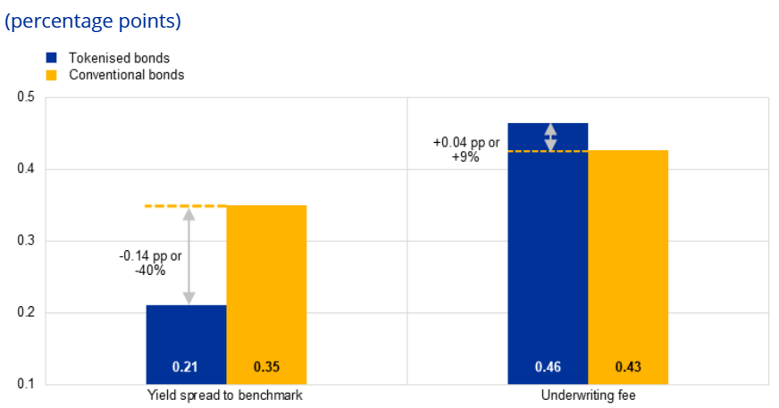
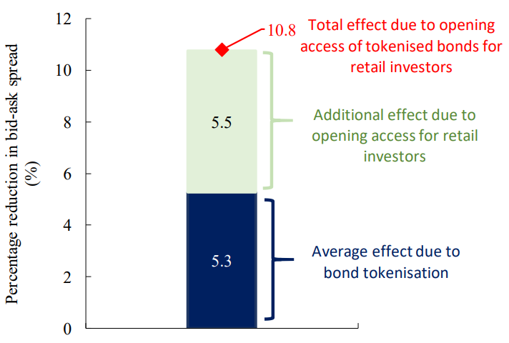
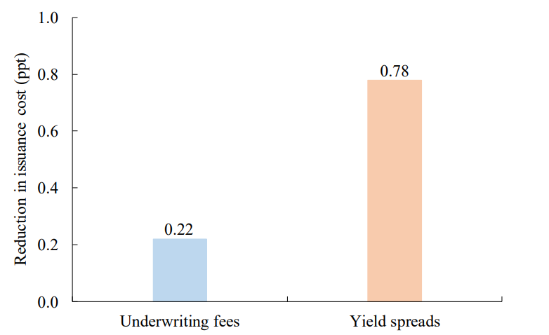
Literature Findings
Lower yield
Higher fees
Better liquidity
Source: https://www.ecb.europa.eu/press/financial-stability-publications/macroprudential-bulletin/html/ecb.mpbu202604_03.en.html#toc5
Lower yield
Lower fees
Source: https://www.hkma.gov.hk/media/eng/publication-and-research/research/research-memorandums/2023/RM04-2023.pdf
Source: https://www.hkma.gov.hk/media/eng/publication-and-research/research/research-memorandums/2023/RM04-2023.pdf
Notes:
When comparing tokenised bonds with conventional bonds in practice, studies find that digital bonds may be associated with lower borrowing costs as confirmed by the European Central Bank study published in April 2026 and by the Hong Kong Monetary Authority at the end of 2023.
In some cases, reduced underwriting fees can also be observed, although results vary across studies. For example, in the ECB study, underwriting fees were higher while in the Hong Kong study the were lower.
The Hong Kong study also suggests that tokenised bonds exhibit higher liquidity, as their bid-ask spreads are found to be lower than the similar conventional bonds by 5.3%, with the improvement doubled to 10.8%.
Overall, the digital bond issuance might have several benefits for both the issuers and investors, but it needs to be addressed, that the overall market is still nascent, and literature findings are not yet fully consistent.

Slide 5
Tokenised bonds in the esg space

Slide 6
Esg relevance
Issuer’s
challenges
Detailed reporting on the allocation and the impact of the bond proceeds
Data collection from different sources
Calculation of ESG metrics
Manual reporting processes are prone to human error, leading to potential inaccuracies and inconsistencies in sustainability impact data.
Investor’s challenges
Limited ability to access real-time data on (re)financed projects
Reliance on periodic issuer reports, with little continuous visibility on project progress
After the green bond is allocated, impact is no longer calculated (lack of life-cycle data)
Must aggregate green data from multiple fragmented sources (annual reports, disclosures, issuer websites)
!
Blockchain-based tokenised bonds can improve data tracking, reporting and impact calculation.

Slide 7
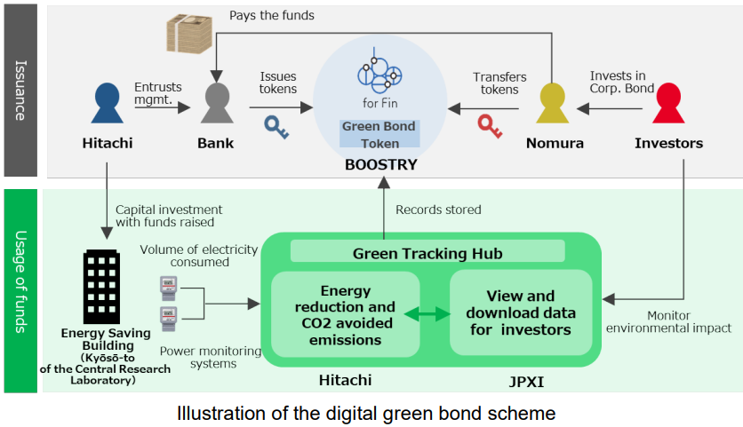
CASE STUDy: Hitachi (2024) digital green bond
Hitachi issued digital green (tokenised) bond on the „ibet for Fin” blockchain platform, operated by BOOSTRY using IoT technology.
The proceeds from the digital green bond were used to refinance the renovation and construction costs of the Kyōsō-to building of Hitachi’s Central Research Laboratory (energy saving building).
Green Tracking Hub jointly developed by Hitachi and JPXI that automatically measures the volume of electricity consumed at the buildings, to which funds were allocated, and converts the volume into a comparison of volume of CO₂ avoided emissions and energy reduction versus benchmarks, and discloses this data to investors.
Source:
https://www.hitachi.com/en/press/articles/2023/11/1116/
https://asianbondsonline.adb.org/events/2025/42nd-abmf-meeting/sf-13feb-session4-akema.pdf
Notes:
In case of Hitachi, the uses of funds are monitored to ensure that the money contributes to the activities and targets identified.
Smart contracts are designed in a way that they can integrate certain types of data, such as CO2 emission reductions. Collected data is securely stored in Green Bond Token.
The mechanism automatically retrieves the building’s energy use and equivalent reduced emissions from power monitoring systems.
The data is visualized and download ready on a web browser (Green Tracking Hub website). If a malicious actor should access the website and rewrite the data there, it will be immediately detectable because the authentic data is entered into the security tokens on a daily basis.

Slide 8

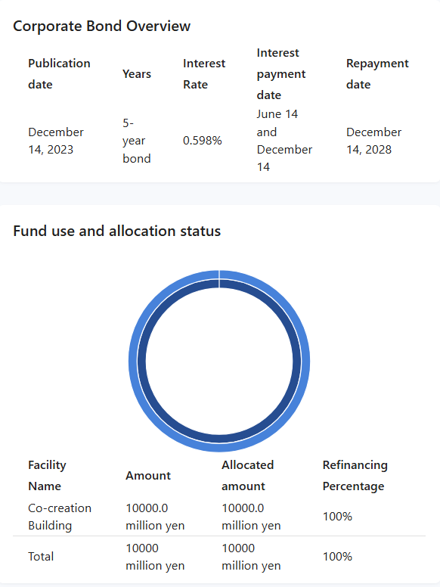
CASE STUDy: Hitachi (2024)
The Green tracking hub website
Source: https://jpx-trackbond.com/
Notes:
On the Green Tracking Hub, project-level details include allocation, project description, location of the allocation is displayed on the website.

Slide 9
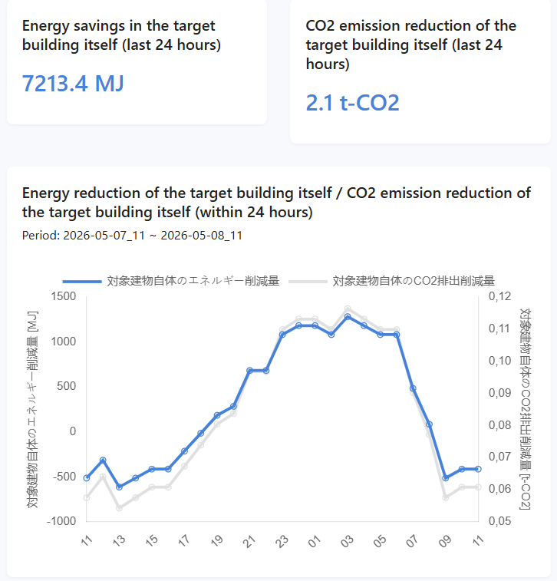
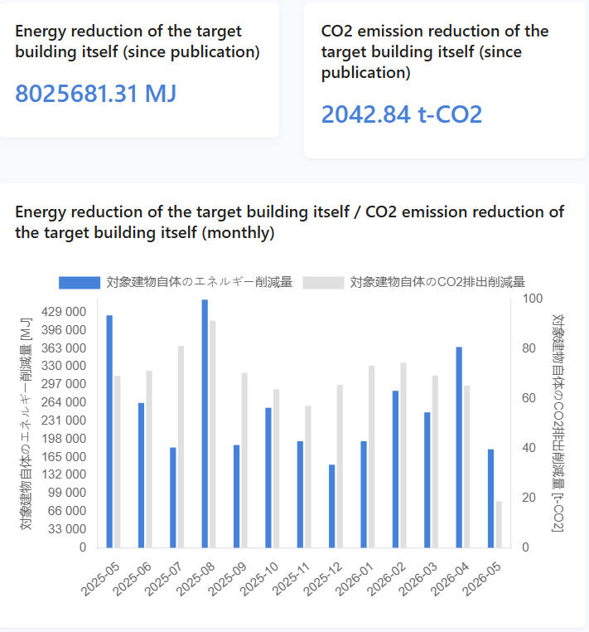
CASE STUDy: Hitachi (2024)
The Green tracking hub website
Source: https://jpx-trackbond.com/
Notes:
Environmental metrics data is recorded automatically and electronically on a daily basis.
The impact calculation methodology can be found at the bottom of the website under the Notes section.

Slide 10
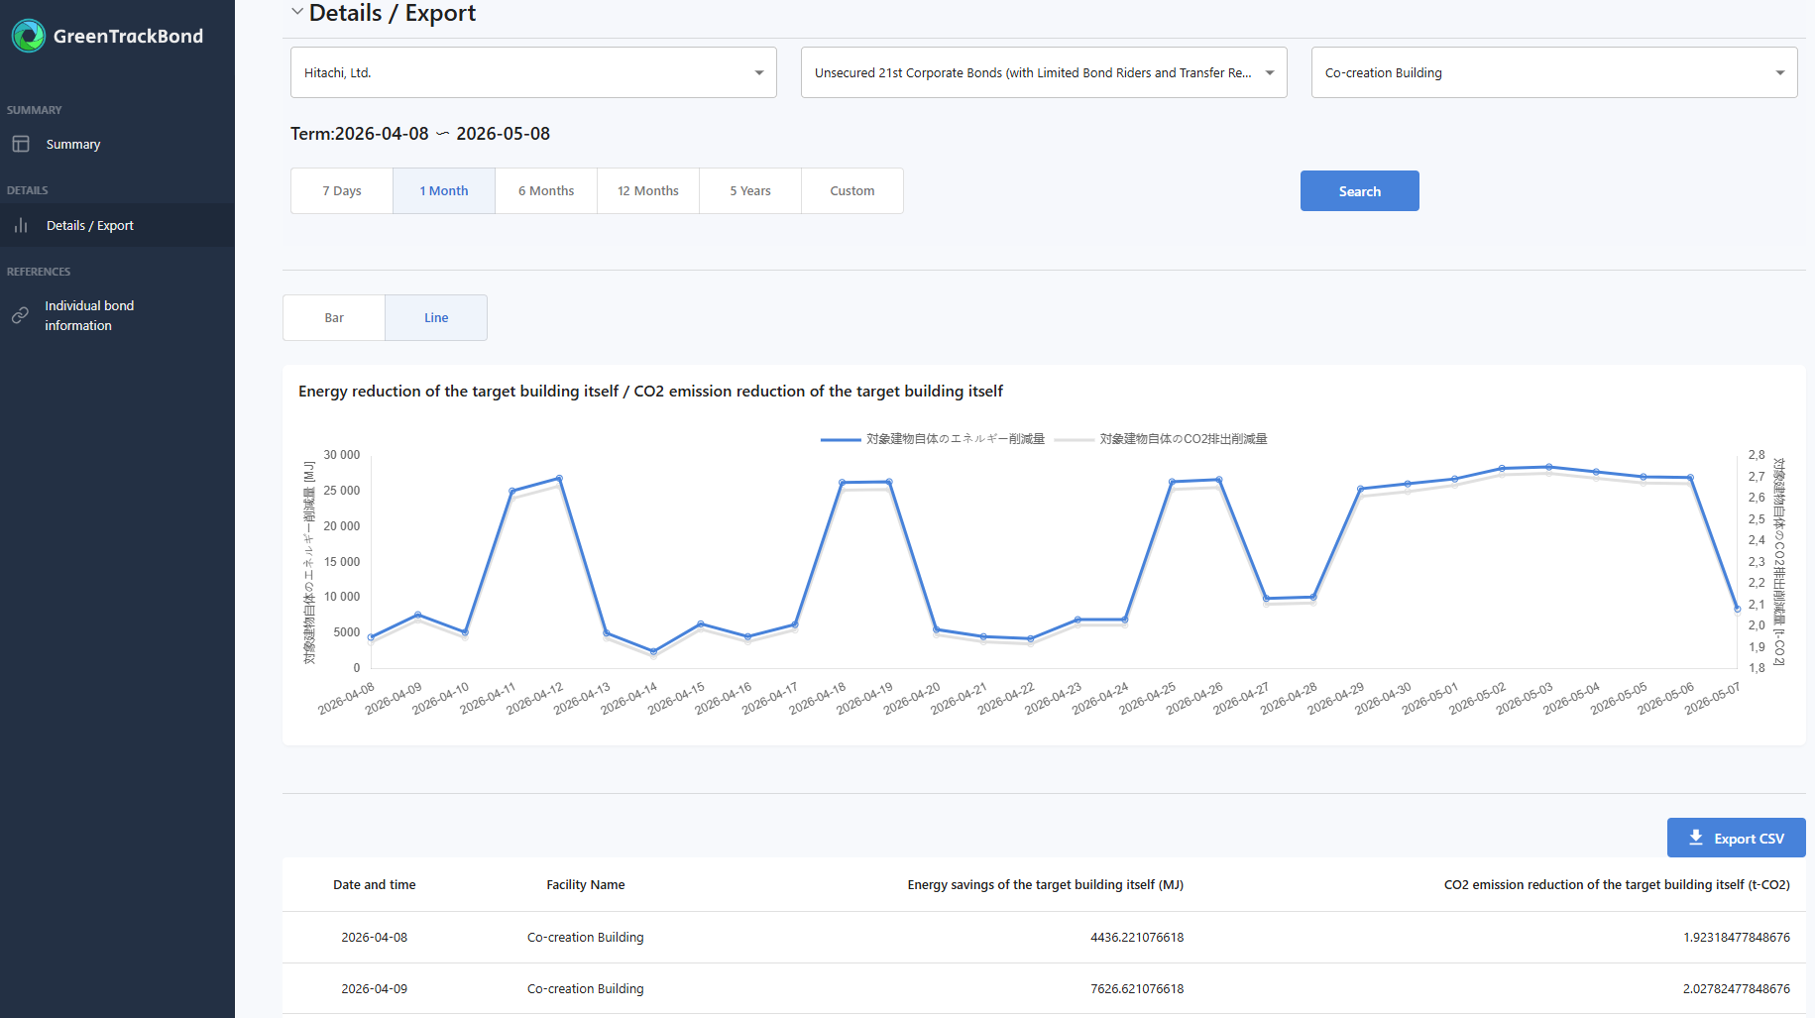
CASE STUDy: Hitachi (2024)
The Green tracking hub website
Source: https://jpx-trackbond.com/
Notes:
Data can also be retrieved on green metrics for a specific time period.

Slide 11
Potential Future use of tokenised bonds in ESG landscape
Opportunities
Smart contracts can automate ESG data monitoring and compliance checks, enabling real-time assessment of sustainability performance and automated execution of coupon adjustments (e.g. in case of sustainability-lined bond¹).
Once the infrastructure and technology are developed, annual reporting would become less time-consuming and costly, as reports could be generated automatically.
With hubs such as Green Tracking Hubs, data could be aggregated on a single platform, making it easier for investors to access and analyse information (improving transparency, comparability).
The impact of certain projects (e.g. solar panels) can last their entire lifecycle, but is often no longer tracked after sustainable bond proceeds are allocated. Blockchain-based solutions like Green Tracking Hubs could enable continuous lifecycle tracking.
Challenges
For sovereign issuers, ESG data availability is often lagged and available at an aggregated level (e.g. annual sovereign emissions statistics) limiting real-time monitoring.
Continuous impact monitoring is typically project-specific, which makes it difficult for sovereign issuers to apply at scale, given that they allocate proceeds across a large number and type of projects.
Developing additional infrastructure, technology and expertise is costly.
High energy demand for digital infrastructure might hamper the credibility of ESG (there are some initiatives aiming to mitigate this problem²).
¹ Sustainability-linked bonds (SLBs) link financial terms (e.g. coupon) to predefined sustainability performance targets (SPTs), such as CO₂ reduction. Depending on whether the targets are met, coupon adjustments (step-up/step-down) are triggered.
² For example SEB and Crédit Agricole CIB’s so|bond platform is a sustainable and open platform for digital bonds built on blockchain technology. The platform aims to improve the environmental footprint of the infrastructures by encouraging participants to minimise their environmental footprint.

Slide 12
THANK YOU FOR YOUR ATTENTION!

